Slide 1

Special Considerations
Version 1 – November 2022

Slide 2
Objectives
To understand the considerations regarding specialist critical care transfers.
To apply these considerations when undertaking specialist critical care transfers.
Version 1 – November 2022

Slide 3
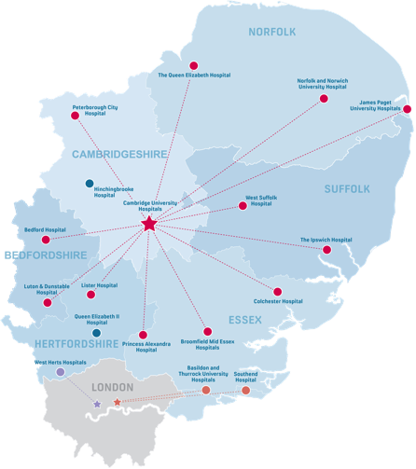
East of England Trauma Network
Version 1 – November 2022

Slide 4
Trauma coordination service
Phone: 0330 330 3999 – 24 hours
Menu system:
Assessment for trauma with triage tool
^{Pre-alerting ED}
^{Clinical decision support}
Request transfers or specialist referral
^{Contact for Rehab co-ordinator}
Version 1 – November 2022
Notes:
Calls to the Trauma coordination services are recorded

Slide 5
ED ‘’Pitstops’’
Version 1 – November 2022
Notes:
The Trauma Network system should ensure that the Emergency Department are aware that you will be arriving. The idea is to ensure the patient is given a quick assessment before moving on to the relevant destination. Also to ensure the patient is entered on to the hospital admission system and given a patient ID band. There have been issues with unlabelled patients and patients in corridors or lifts that need urgent medical attention beyond the contents of the transfer bag.

Slide 6
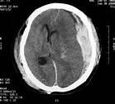
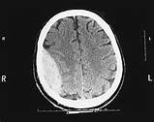
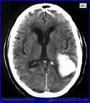
Neurological and Spinal Injuries
Topics covered within this section:
Causes and mechanisms of injury
Indications for intubation in neurological patients
Parameters
Considerations and management with neurological patients
Collars and immobilisation
Version 1 – November 2022

Slide 7
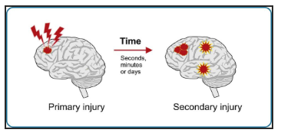
Aims of management of neurological injury
Suspect and identify injury
Identify those needing neurosurgical intervention
Minimise secondary brain injury: contusions, shock, cerebral oedema, haematomas causing increased ICP, intracranial infection
Version 1 – November 2022
Notes:
A secondary survey should be completed following primary survey, before transfer out to another hospital. Injuries such as Leg, ankle and wrist fractures could be missed by transferring hospital personnel. These could be stabilised to help prevent pain for the patient on the transfer.
Discussion with delegates, how to package this type of patient for transfer.
Transfer of patients with brain injuries can be potentially hazardous, if poorly performed. Poor transfers can result in significantly greater secondary brain injury with worse patient outcomes as a result.

Slide 8
Causes and Mechanisms of injury
Causes
RTC
Falls
Sports
Assault
Self-harm
Non-Traumatic
Version 1 – November 2022

Slide 9
Indications for intubation
Indications for intubation for brain injured patients
1. GCS ≤ 8
2. Significantly deteriorating conscious level (e.g. a fall in GCS of two points or more, or a fall in motor score of one point or more)
3. Loss of protective laryngeal reflexes
4. Failure to achieve PaO₂≥ 13 kPa; but, a lower target can be accepted in patients with AIS (aim for peripheral oxygen saturation≥ 95%)
5. Hypercarbia(PaCO₂ > 6 kPa)
6. Spontaneous hyperventilation (PaCO₂ < 4.0 kPa)
7. Bilateral fractured mandible
8. Copious bleeding into the mouth (e.g. from skull base fracture)
9. Seizures
(Nathanson et al., 2019) – Guidelines for the safe transfer of brain injured patients
Version 1 – November 2022

Slide 10
Management of neurological injuries
Consideration
Transduce at the tragus
2. Establish target parameters for the type of brain injury – check with neuro team
3. Not too tight ETT ties, anchor-fast is ideal
4. Head neutral alignment
5. Blood glucose 6-10
6. 36–37°C
7. 20–30° head-up tilt
8. Record pupils – pre and during
9. Avoid rapid acceleration and deceleration
10. Avoid hypoxia and hypotension
11. PaO2 of ≥ 13 kPa and PaCO2 of 4.5–5.0 kPa
12. Hands off Handover at receiving hospital
Key points when transferring neuro patients:
(Nathanson et al., 2019) – Guidelines for the safe transfer of brain injured patients
Version 1 – November 2022
Notes:
There exists a balance, however, between the ideal list above and the real world environment where difficulties gaining invasive access may significantly delay life-threatening surgery.
Sometimes compromise is needed and it is always worth discussing these with the surgeons/anaesthetists at the receiving hospital if in doubt.
Significant evidence in head injury to show MAP below 90 mmhg is associated with increased morbidity and mortality
Collars and ET ties should not be over tight as this will prevent cerebral venous drainage and therefore increase ICP.
Once stabilised the neuro patient must be monitored to ensure these parameters are maintained. Thus ETCO2 and Sats should be on monitor so it can be monitored throughout transfer.
As hypothermia is linked to increased mortality and morbidity measure temp throughout the transfer aiming for 36-37

Slide 11
Parameters
 | TBI (including TSAH | ICH/Haemorrhagic stroke | Acute Ischaemic Stroke | Spontaneous SAH
Systolic BP (mmHG) | >110 (and MAP >90) <150 | <150 if within 6 hours of onset of symptoms/immediate surgery planned | <140 <185 (if candidate for/has received thrombolysis; or <220 if thrombolysis is contraindicated and being transferred for thrombectomy | >110 <160
PaCO2 (kPa) | 4.5-5.0 | 4.5-5.0 | 4.5-5.0 | 4.5-5.0
PaO2 (kPa) | >13 Avoid <95% sats | >13 Avoid <95% sats | >13 Avoid <95% sats | >13 Avoid <95% sats
(Nathanson et al., 2019) – Guidelines for the safe transfer of brain injured patients
Version 1 – November 2022

Slide 12
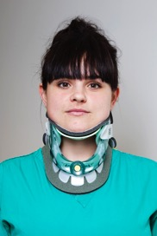
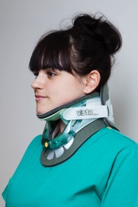
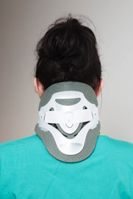
Collars
Should be properly sized and fitted (see below)
Version 1 – November 2022

Slide 13
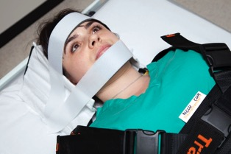
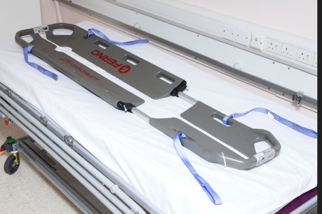
Spinal immobilisation
Ac B C
Immobilise to prevent secondary injury
^{Immobilise until “cleared”}
Version 1 – November 2022
Notes:
Spinal immobilisation needs to be maintained until cleared by CT scan and orthopaedics.
This will mean log rolling patient.
Check all staff no procedure first and clear instruction.
Ac need to maintain cervical immobilisation during insertion of definite airway.

Slide 14
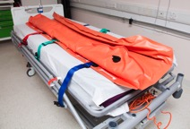
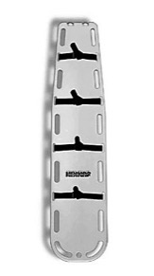
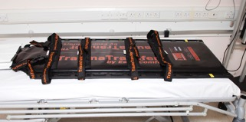
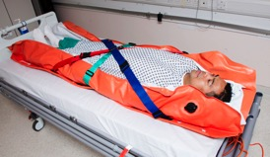
Immobilisation Boards
Vacuum
Mattress
Long board
Vacuum mattress
Trauma board
Long Board
Trauma Board
Version 1 – November 2022

Slide 15
Manual Handling
Every move involves a high-risk procedure
Adequate numbers of competent staff (log rolling – minimal of 5 personnel)
Be aware of flaccid limbs
Version 1 – November 2022

Slide 16

Balloon Pump Transfers
Contributions and special thanks to:
Royal Papworth Hospital, clinical lead and ECMO nurse specialist
Version 1 – November 2022

Slide 17
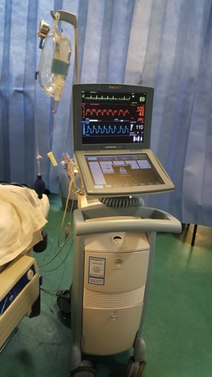
Balloon Pump Transfers
Aortic counter pulsation device in the management of acute coronary ischaemia and severe heart failure
These patients can be extremely sensitive to the gravitational/motion effects on preload and cardiac function
Trial pause/disconnection in ICU prior to departure if it will be necessary during transfer
Transferred with specially trained staff, often a perfusionist
Version 1 – November 2022

Slide 18
Balloon pump transfer
^{Difficult Transfers due to :}
Weight of the balloon pump (70kg)
^{Slows down movement}
^{Runs off battery}
Not all ambulances can accommodate balloon pump on tail lift with patient
May need to stop pumping and disconnect while loading patient
Securing in ambulance requires specialist brackets that fix around a chair
Version 1 – November 2022
Notes:
Expert knowledge to disconnect and rezero and start pumping again.
Battery life unknown as rechargeable so may need to take spare battery (also very heavy)
Work out oxygen requirements taking into account slow movements !! Really does slow you down
Due to manual handling issues and tail lift requirements Ambulance control should be made aware as they often have a set procedure
Make sure it is fixed securely otherwise it is a very dangerous missile It takes up the side chair so limits amount of space and means one of the staff on transfer has to sit rear facing (travel sickness!!!)
Best policy to go down to ambulance to secure bracket and spare battery before moving patient.

Slide 19
Paediatric Transfers
Contributions and special thanks to:
Lead Nurses for Education from the East of England regional transfer service (PaNDR)
and Paediatric Critical Care Operational Delivery Network

Slide 20
Objectives
To gain an understanding in undertaking paediatric transfers.
To be able to utilise the regional paediatric transfer service (PaNDR).
To be able to apply the paediatric drug calculator.

Slide 21
Introduction
PaNDR is the EoE regional transfer service for paediatrics.
PaNDR will arrange for mutual aid for paediatric transfers only after all other options have been exhausted.
PaNDR will offer clinical support throughout.
Referrals made by calling: 01223 274274

Slide 22
How can you be prepared?
Early recognition of the critically ill child to mobilise team within the hospital.
Early communication with PaNDR.
Follow PaNDR clinical guidance for common/uncommon presenting illnesses.
https://pandreastofengland.co.uk/

Slide 23
Paediatric drug calculations
Use drug calculator from PaNDR website.
https://pandreastofengland.co.uk/drug-calculators
Input: name, weight, DOB, todays date. Then doses are automatically calculated.
Notes:
Work is currently being undertaken by the paediatric critical care society to produce a standard formulary / prescription for paeds ICU and retrieval.
Paediatric units are able to get this populated and printed – utilise them and ask upon arrival

Slide 24
Drug Calculations
Weight calculation is only suitable for over 1 years old. <1 year, estimate.
At birth – 3kg, 6 months – 6kg.
Use of peripheral adrenaline infusion has become standard and is included in the CATS on line prescriptions as an option.
Use of peripheral noradrenaline can be used (eg for children presenting with PIMS TS and warm shock post covid-19).
Ketamine is recommended for induction over propofol – reduces risk of hypotension and vasodilation.

Slide 25
Normal Values
Age (years) | Heart Rate/minute | Respiratory Rate/minute | Systolic Blood Pressure
<1 | 110-160 | 30-40 | 70-90
1-2 | 100-150 | 25-35 | 80-95
2-5 | 95-140 | 25-30 | 80-100
5-12 | 80-120 | 20-25 | 90-110
Over 12 | 60-100 | 15-20 | 100-120

Slide 26
WET FlAG
 |  | Formula | Example for 2 year old | Answer
W | Weight (age 1 to 10) | (Age + 4) x 2 (kg) | (2+4) x2 | 12
E | Energy/electricity | 4 x weight (kg) = Joule | 12 x 4 | 48
T | Tube (endotracheal) | Age/ 4 plus 4 = ID mm | 2/4 + 4 | 4.5
Fl | Fluids (bolus) | 10 x weight (kg) = mL Normal saline | 10 mL x 12kg | 120mL
A | Adrenaline | 10 mcg/kg 1:10000 solution = 0.1 ml/kg | 10mcg x 12kg | 120mcg 1:10000 = 0.1ml/kg
G | Glucose | 2 mL kg (10% Dextrose) | 2 mL x 12kg | 24mL 10% Dextrose
⁻¹
⁻¹

Slide 27
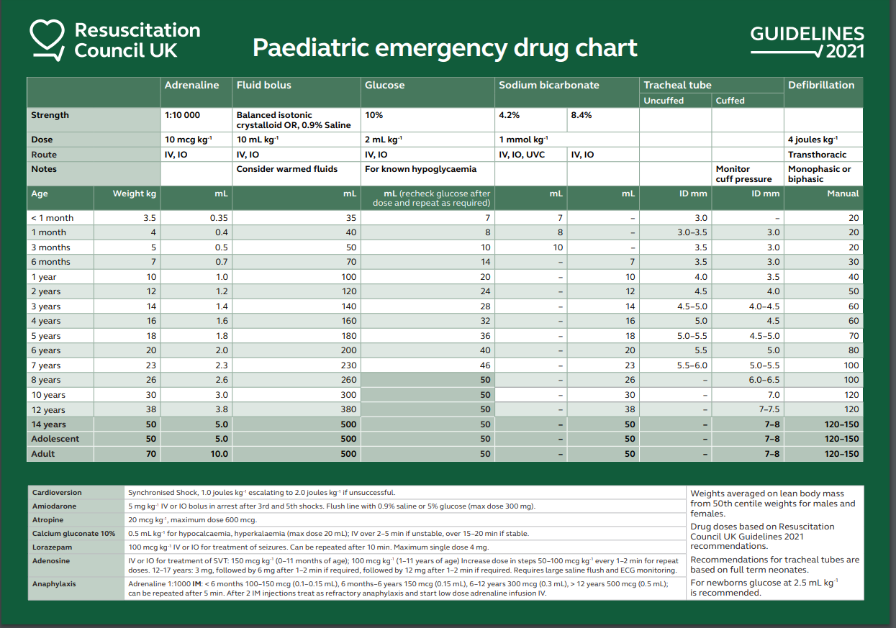
WET FlAG

Slide 28
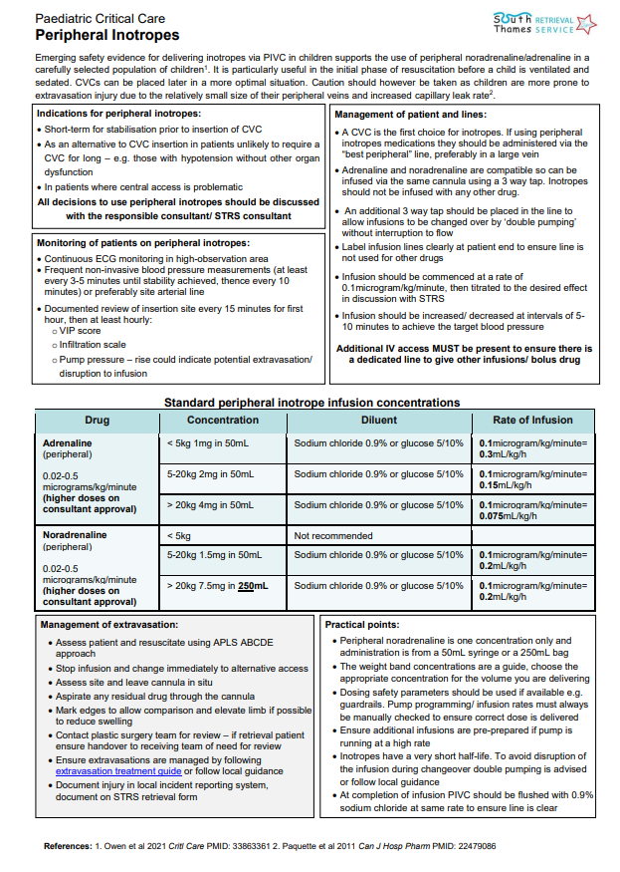
Peripheral inotropes in paediatric critical care
South Thames Paed Retrieval Service (STRS) pdf of peripheral inotropes prep and administration
https://www.evelinalondon.nhs.uk/resources/our-services/hospital/south-thames-retrieval-service/peripheral-inotropes.pdf

Slide 29
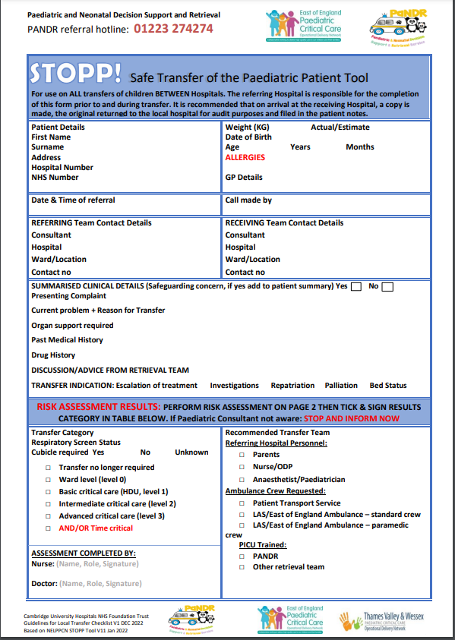
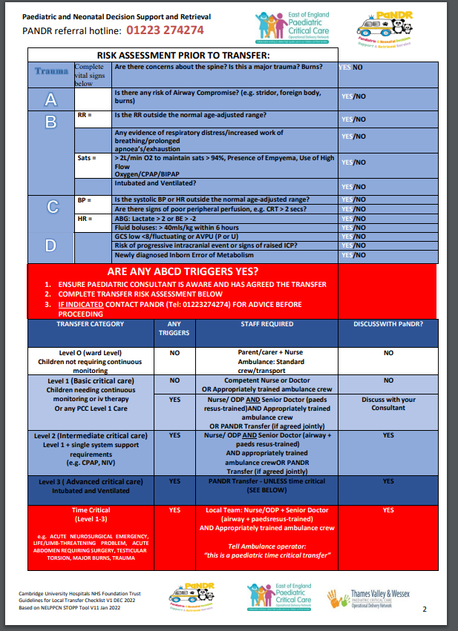
STOPP
Notes:
This is the STOPP tool, used by most UK Paediatric transfer services.
It was designed for staff who need to bring in a time critical paediatric patient.

Slide 30
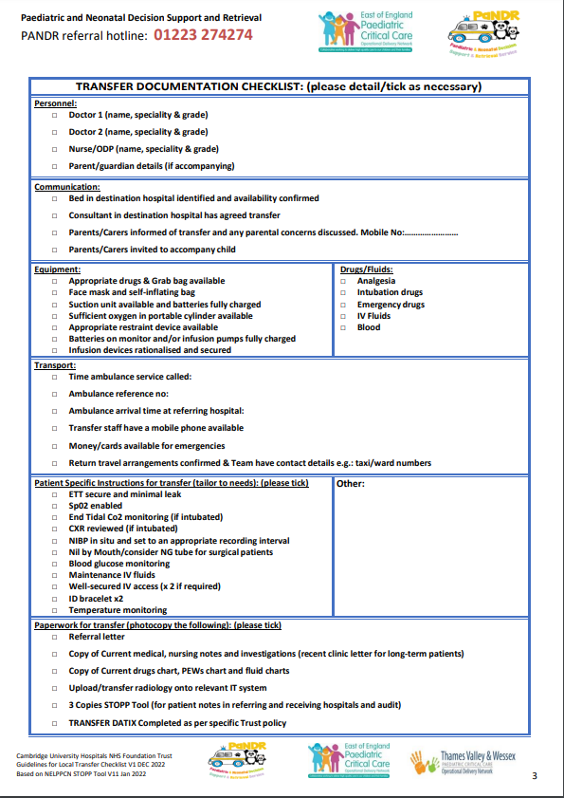
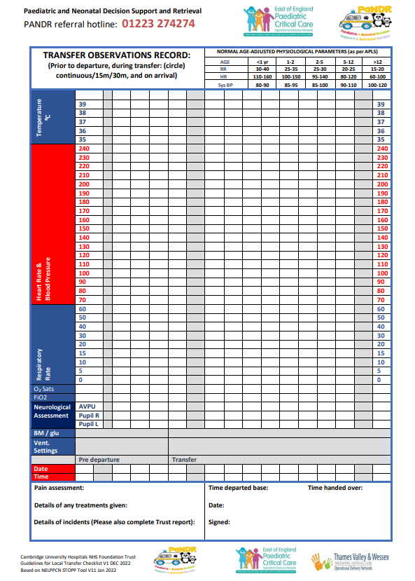
STOPP

Slide 31
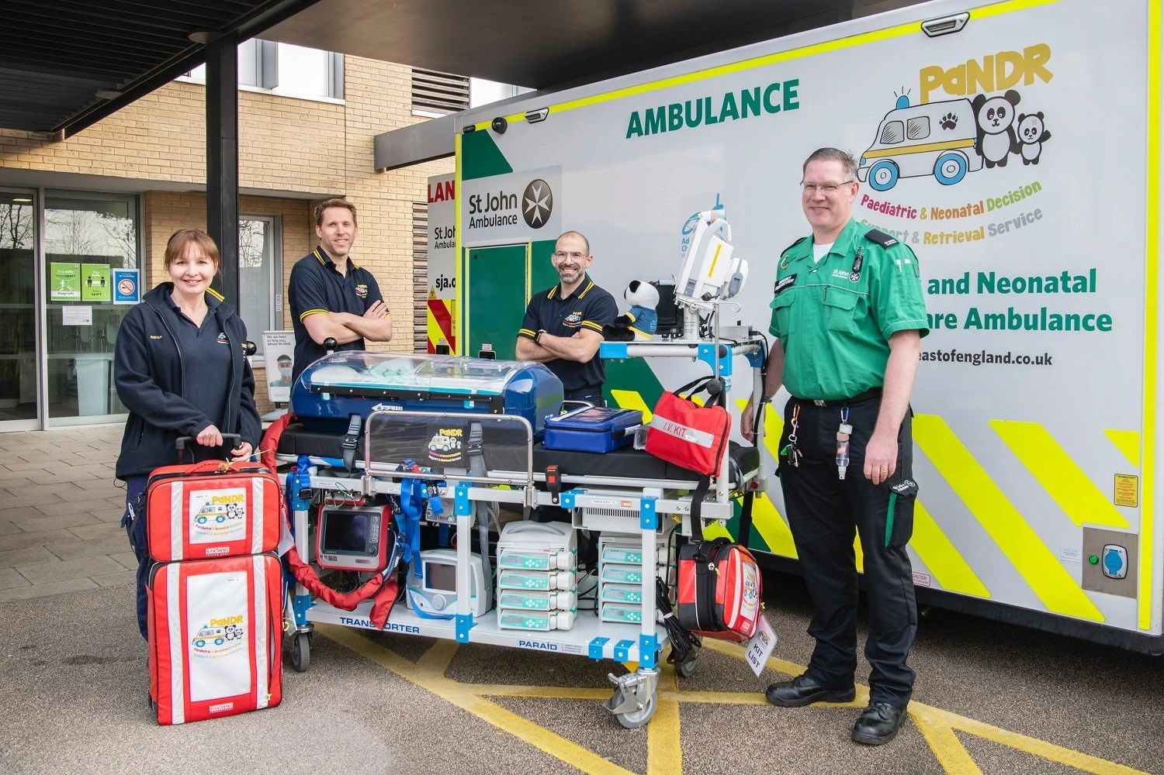
Questions?

