Slide 1
Additional reading material
Version 1 – November 2022

Slide 2
Acceleration, G-force, ambulance crashes
Man Kinds Limits - https://www.youtube.com/watch?v=M5zOWIDnfJI
G Force - https://www.youtube.com/watch?v=DMKcO-T5Y4o
In an ambulance - https://www.youtube.com/watch?v=RayVNi10W8U
Version 1 – November 2022

Slide 3
Physics of Acceleration
Defintions:
Speed: The distance travelled in a given unit of time regardless of direction (mph/kph/metres per second).
Velocity: The speed applied to a given direction.
Force: Newtons first law states that an object will remain at a constant velocity or state of rest unless a force is applied to it. Force causes acceleration. Measured in (N) – Newtons.
Weight: When the force of gravity is applied to a mass it gives rise to the force we sense as weight.
Acceleration: A rate of change of velocity measured in m/s squared. It can be positive or negative (deceleration). Newtons second law states that acceleration is directly related to the force applied to it and inversely proportional to the mass of the object.
Version 1 – November 2022

Slide 4
Sources of Acceleration - Long
Long duration: >2 seconds in excess of 1G.
Causes: change of rate of movement (linear) or change of direction (radial) or both (angular).
Effects/considerations: shift in fluid volumes, reduced tolerance to G force.
Think road….. think rate, duration, magnitude and direction of acceleration.
Think patient.. Hypoxia, hypovolemia, acidosis, hypoglycaemia. Compensatory mechanisms.
Version 1 – November 2022

Slide 5
Sources of Acceleration - Short
Short Duration: <1 second.
Causes: Crash/impact.
Effects/considerations:
Magnitude and duration: The greater the magnitude and longer it is applied, the higher the incidence of injury.
Rate of onset: If this can be buffered, greater survivability.
Direction of Force: Gz axis forces cause the greatest organ displacements.
Site of application: Larger surface areas or stronger bony structures provide greater protection from injury.
Version 1 – November 2022

Slide 6
Whose the creep?
(Low and Hulme, 2015)
C = Container – the structure must be of strong enough to prevent intrusion into the designated survival area (inside the ambulance)
R = Restraint – Use of seatbelts/harnesses provides sufficient strength to maintain the team and patient
E = Energy attenuation – crumple zones attenuate energy, reducing exposure deceleration forces (seats)
E = Escape – Failure to escape will cause morbidity and mortality……. (think exit route)
P = Post crash factors – fire extinguishers, break a glass hammer
Version 1 – November 2022
Notes:
Factors pertaining to the design of the ambulance. If there was a crash involving the ambulance these are the different factors to think of that would protect your patient, yourself and your colleagues

Slide 7
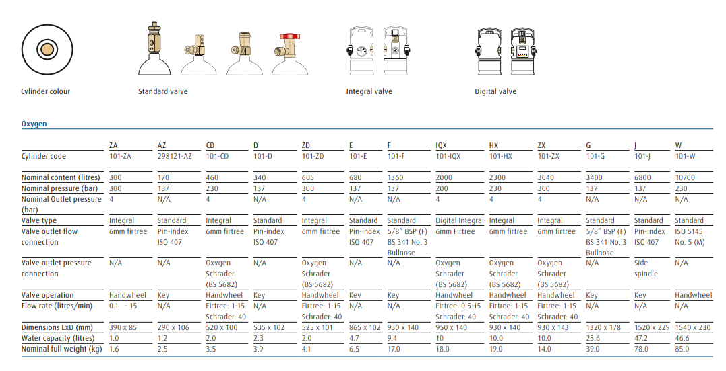
Equipment – Oxygen
Version 1 – November 2022

