Slide 1
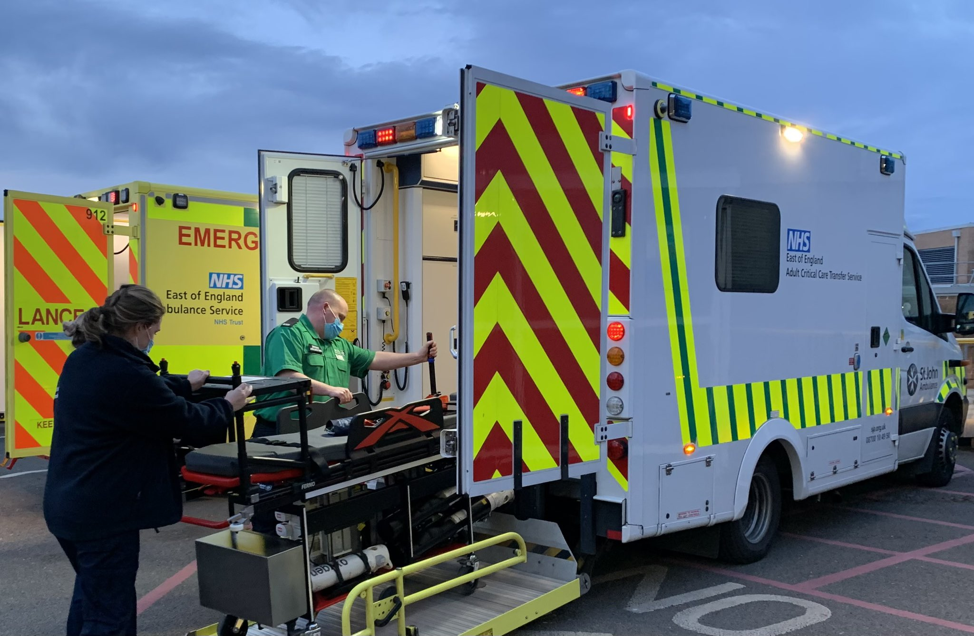
Transfer Preparation – A systematic approach
Version 1 – November 2022

Slide 2
Objectives
To understand and apply a systematic approach when preparing an adult critical care patient for transfer.
To understand and apply a systematic approach when transferring an adult critical care patient.
To discuss and understand the current and potential considerations for packaging patients that require a critical care transfer
Version 1 – November 2022
Notes:
Key principles:
Transfers are the most vulnerable time for any patient.
You are a mobile, mini ICU, outside of a place of safety.
It is a skill to say ‘no’ to transfer, or ‘I want more time’ or ‘I need more experience’
Preparation and planning are key to safe transfers.
Assume nothing and plan for the unexpected.
All patients should ideally be adequately resuscitated and stabilised prior to transfer.
Patient packaging is a process which involves systematic monitoring occurs with additional support that may be required during transportation.
Standardising this approach reduces the risk of adverse events during transfer.
It is the transferring teams responsibility to protect patients from harm and environmental hazards associated with critical care transfers

Slide 3
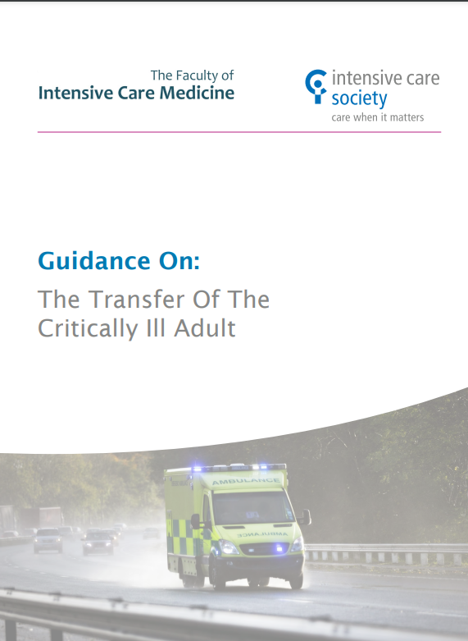
Guidelines
Intensive Care Society Guidelines (2019)
Version 1 – November 2022

Slide 4
What is the systematic approach?
Airway
Breathing
Circulation
Disability
Exposure
Version 1 – November 2022

Slide 5
Airway
Any self ventilating patient considered at risk of airway compromise or ventilator insufficiency during transfer should be electively intubated and ventilated prior to departure.
What causes can you think of that may require the patient to be intubated prior to departure?
Airway must be secured prior to departure and cuff pressure checked pre-departure.
Version 1 – November 2022
Notes:
What questions do we need to ask ourselves with regards to the airway?
What airway does the patient have?
Is the airway secure? How is it secured?
Will the airway remain secure if the patient is moved?
What is the grade of intubation?
Is the patient alert/talking/maintaining their own airway?
If the patient has a tracheostomy, what equipment do I need to bring with me?
Will the patients airway deteriorate?
What are the potential causes of airway deterioration?
Neurological – GCS <8
Aspiration/vomiting
Oedema – Burns, infection, facial fractures
Bleeding
Considerations?
Tracheostomies and emergency management
Airway management – Intubate?

Slide 6
Airway
ETT position should be confirmed, adequate oxygenation and ventilation of patient.
Recommendation: ‘Pre-departure ABG’
Pulse Oximetry: Inaccuracy in hypotension or poorly perfused digits. Motion artefact. Only tells us about arterial oxygen saturation. Vibration causes dislodgement.
ETC02: Fluctuates with respiration
Version 1 – November 2022

Slide 7
Breathing
What are the breathing considerations for our patients?
Ensure adequate oxygenation and ventilation prior to departure.
Conduct a thorough respiratory assessment.
Ensure appropriate patient positioning and suctioning prior to departure.
Establish what type of ventilator will be used.
Establish ventilator mode.
Version 1 – November 2022

Slide 8
Breathing
What is the mandatory monitoring for a ventilated patient?
Capnography
‘Capnography / end tidal CO2 monitoring is mandatory in all intubated ventilated patients. Systems for monitoring end tidal CO2 during non-invasive ventilation are becoming available and may be of value in monitoring airway patency and adequacy of ventilation.’ –
Intensive Care Society - 2019
Version 1 – November 2022
Notes:
Use of anchorfasts: https://www.youtube.com/watch?v=DGT48E_9JCQ
Tying an ETT Tube: https://www.youtube.com/watch?v=kqAooVu__a4
Tracheostomy tie/dressing change: https://www.youtube.com/watch?v=rXW2MPSxFrU

Slide 9
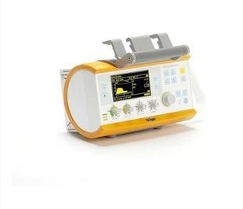
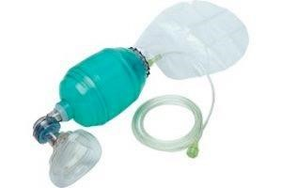
Breathing
Oxygen and ventilation
Have you got enough oxygen?
Calculate your oxygen requirements, is this enough? Plan for double.
Establish what type of ventilator you are going to use, what is your backup?
Providing manual ventilation with oxygen is mandatory.
Version 1 – November 2022

Slide 10
Breathing
Oxygen cylinder size | Capacity (litres)
D | 340
CD | 460
E | 680
F | 1360
ZX | 3040
Version 1 – November 2022

Slide 11
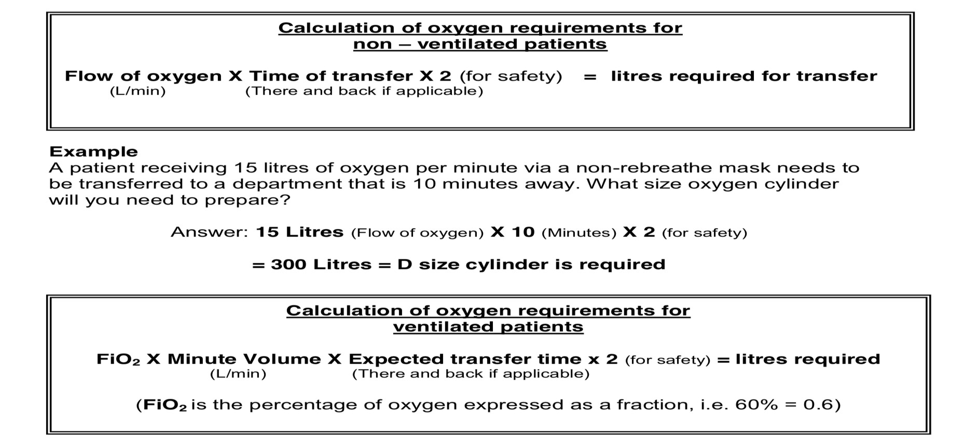
Breathing
How to calculate oxygen requirements:
Version 1 – November 2022

Slide 12
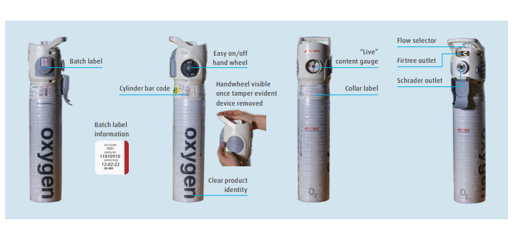
Breathing
Oxygen Safety:
https://www.bochealthcare.co.uk/en/images/Download%20oxygen%20integral%20valve%20cylinder%20instruction_tcm409-54069.pdf
Version 1 – November 2022
Notes:
Two way communication with your team – ‘Oxygen open, oxygen attached, oxygen detached,’
Use others oxygen sources to conserve your own supply!

Slide 13
Breathing
You have a ventilated patient, prior to transfer what do you need to do?
Establish on portable ventilator – mode
Ensure ABG is adequate and adjust as required (at least 15 mins prior)
Ensure patient is adequately sedated +/- muscle relaxed
EtC02
Monitor peak pressures and minute volume
Version 1 – November 2022

Slide 14
Circulation
National guideline recommendations
‘Minimum standards of monitoring must be applied in every case. Monitoring should be continuous throughout the transfer. All monitors, including ventilator displays and syringe drivers should be visible to accompanying staff.’ – ICS, 2019.
‘All monitoring and equipment must be suitable for use in the transfer environment and mounted on the transfer trolley in such a way as to be CEN compliant.’ – ICS, 2019.
Version 1 – November 2022
Notes:
Consider back up monitoring:
Portable NIBP machine
Portable saturations probe
Consider using EEAST monitoring in the ambulance

Slide 15
Circulation
ECG monitoring is required for all patients – 3 or 5 lead.
NIBP monitoring uses more battery power and shortens the life of the battery.
NIBP is sensitive to motion artefact and unreliable in a moving vehicle.
Invasive arterial monitoring should be initiated for most patients. Where though? Phlebostatic axis (general) / Tragus (reflects circle of Willis/Neuro).
Consider placing defibrillation pads or pacing pads on unstable patients prior to transfer.
Version 1 – November 2022

Slide 16
Circulation
What are the circulation considerations for transferring our patients?
Thorough assessment of circulation and perfusion.
Are there signs of hypovolemia? Is blood needed?
Does the patient has x2 secure points of IV access.
Consider inotropes/vasopressors – central access.
Consider fluids (colloid/crystalloid).
Adequate and appropriate monitoring.
Catheterise.
FULL PATIENTS TRAVEL BETTER!
Version 1 – November 2022
Notes:
Water bottle analogy
Top tips:
The best monitor is you!
Continuous presence of appropriately trained and experienced staff.
Monitoring should be appropriate for the patient need.
In unstable patients, invasive arterial monitoring is essential.
NIBP is unreliable on the move or in an ambulance.
NIBP consumes battery power life.
In time sensitive situations, failure to establish arterial access should not delay transfer.
Extra food for thought:
Arterial lines: accessible, clearly identified and labelled to avoid inadvertent injection.
Monitoring: audible and visual alarms, including limits. Consider ambient noise of the ambulance.
Blood: If major haemorrhage pack (MHP) is to be used, remember the following:
ensure MHP is sealed and time of return to blood bank if not used known.
Document as per local policy
If blood not used, return to receiving hospitals blood laboratory as soon as possible.
Document if blood not used, who returned to and times – governance purposes.

Slide 17
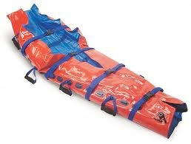
Disability
What do you need to consider when transferring your patient?
Neurological assessment (ACVPU/GCS)
Pupil check before and in transit and at arrival.
Document your finding.
Injury should be assumed until proven otherwise.
Ensure adequate pain control.
C-spine control until fully cleared – documented.
Reduce fractures/stabilise before transfer.
Version 1 – November 2022
Notes:
Critically ill patients suffer from impaired temperature homeostasis and struggle to adapt to changes in ambient temperature.
Exposed patients may develop hypothermia.
Recommendation: Normothermia
Active warming is difficult during transfer. Consider pre-warmed ambulance, blankets.
Monitoring of temperature (pre departure and arrival).

Slide 18
Disability
What about blood sugars?
Blood sugars should be checked prior to transfer - utilise ABG.
Insulin should be started in patients with DKA as per protocol – means of measuring.
If fed, stop NG feed, aspirate, place on free drainage if appropriate.
TPN.
Version 1 – November 2022

Slide 19
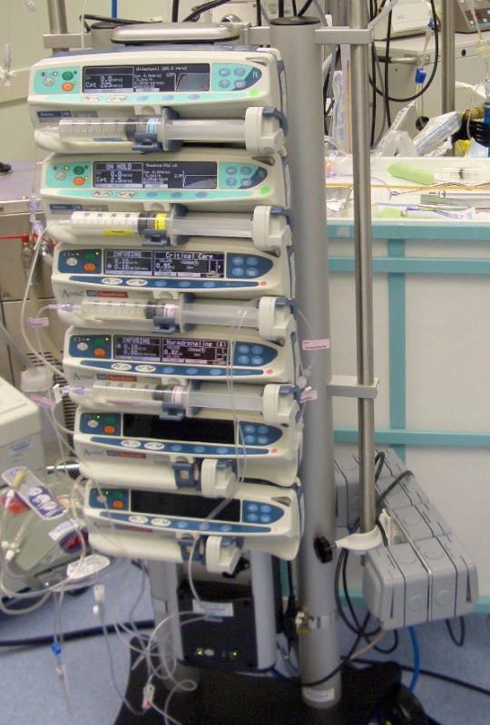
Exposure
Expose your patient to check for?
Wounds
Pressure areas
Chest
Abdomen
Fractures
Always remember patient dignity and privacy!
Version 1 – November 2022

Slide 20
Additional Considerations 1
Consideration | Solution
Drugs | Only take essentials Take twice as much as required for backup Label correctly Stop all non-essential infusions
Electrolytes | Optimize as much as possible prior to departure Blood glucose >4mmol/l Ionised calcium >1mmol/l Potassium <6mmol/l Acid-base balance - acceptable
Line Security | Secure lines Clearly visible/accessible x2 minimum IV access
Drains | Empty prior to departure – document Secure
EXPECT THE TRANSFER TO TAKE TWICE AS LONG AS ANTICIPATED!
Version 1 – November 2022

Slide 21
Additional Considerations 2
Consideration | Solution
Crew skill mix | Appropriately trained staff to only undertake transfer It is a skill to say ‘no’ or ask for support ILS trained? Defib trained?
Infection control | PPE Covid status Infection status Pregnant staff Follow local policy
Patient weight | <250kg on ACCTS trolley Check safe working load
Documentation | Transfer form Print notes
Timings | Time critical transfer Urgent Non-urgent Document delays
Version 1 – November 2022

Slide 22
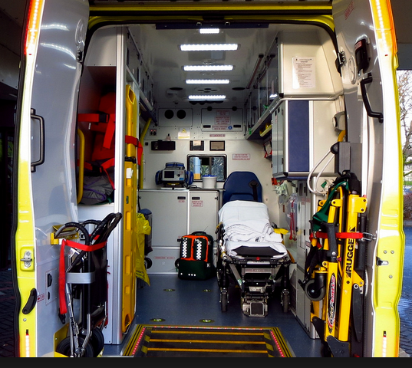
Personal Considerations
High visibility jackets
Mobile – communication device
Money
Food
Travel home considerations
Version 1 – November 2022

Slide 23
Pre-Transfer Assessment – Putting it all together
Now, where were we?
You have applied the ABCDE principles in preparing your patient.
This has involved meticulous planning and preparation.
You have utilized teamwork and communication.
ASK YOURSELF……. ‘IS MY PATIENT READY TO GO ON TRANSFER?’
Version 1 – November 2022

Slide 24
Stop and Reassess
Once you have asked yourself, ‘is my patient ready to go on transfer’…
Reassess ABCDE
Reassess Drugs
Recheck equipment
Ask questions – Transferring team
Transfer form/checklist
Have you checked everything yourself
Have you reduced the risk of transfer to the lowest possible level
Has the receiving area (CT/MRI/Unit) been called?
Version 1 – November 2022

Slide 25
When Receiving a patient
When receiving a patient, from somewhere, remember the following…..
Anticipate and prepare for arrival
Patient may arrive unstable
Be kind and compassionate to the transferring team and patient
Privacy and dignity at all times
Handover – Hands off
ABCDE Assessment
Documentation
Return equipment/transfer form/patient property
Version 1 – November 2022

Slide 26
Summary
Critical care patients due to their conditions are unstable. They require meticulous stabilization and resuscitation in a safe environment prior to transfer.
The safety of the patient is your responsibility until you have handed over at the destination.
Volume resuscitated patients travel better.
Avoid hypoxia.
Assume nothing, plan and prepare for the worst.
NOBODY GETS BETTER DURING A TRANSFER!
Version 1 – November 2022

Slide 27
References
Association of Ambulance Chief Executives. National Framework for Inter-facility transfers. 2018.
Evans, C, Creaton, A. and Kennedy, M., 2017. Retrieval Medicine. Oxford: Oxford Publishing Press.
Intensive Care Society, 2019. The Transfer of the Critically ill Adult. London: Intensive Care Society: London.
Kulshrestha, A. and Singh, J., 2016. Inter-hospital and Intra-Hospital patient transfer: Recent concepts. Indian Journal of Anaesthesia, 60(7), pp.451-457.
Low, A., and Hulme, J., 2015. ABC of Transfer and Retrieval Medicine. London: Wiley Blackwell.
Parmentier-Decrucq, E., Poissy, J., Favory, R., Nseir, S., Onimus, T. and Guerry, M.J., 2013. Adverse events during intrahospital transport of critically ill patients: Incidence and risk factors. Annual of Intensive Care, 3(10).
Venkategowda P. Rao S, Mutkule D, Taggu A, Unexpected events occurring during the intra-hospital transport of critically ill ICU patients. Indian Journal of Critical Care Medicine. 2014;18(6):354-7.
Mental Capacity Act, 2005. London: UK Government.
Karger, S. and Basel, A.G., 2021. Principles of Clinical Ethics and Their Application to Practice, Medicine Clinical Practice, 30, pp.17-28.
Nursing and Council, 2015. NMC Standards of Practice, guidance for Nurses and Midwives. London: Nursing and Midwifery Council.
SBNS Society of British Neurological Surgeons Care Quality Statement. 2015. www.sbns.org.uk/index.php/download_file/ view/975/87 (accessed 23/04/2018).
Wahlgren N, Moreira T, Michel P, et al. Mechanical thrombectomy in acute ischemic stroke. International Journal of Stroke 2016; 11: 134–47.
Wijdicks EFM, Sheth KN, Carter BS, et al. Recommendations for the management of cerebral and cerebellar infarction with swelling. A statement for healthcare professionals from the American Heart Association/American Stroke Association. Stroke 2014; 45: 1222–38.
Intercollegiate Stroke Working Party. National clinical guidelines for stroke, 5th edn. London: Royal College of Physicians, 2016. http://www.strokeaudit.org/SupportFiles/ Documents/Guidelines/2016-National-Clinical-Guideline-forStroke-5t-(1).aspx (accessed 23/04/2018).
Berkhemer OA, Fransen PSS, Beumer D, et al. A randomized trial of intra-arterial treatment for acute ischemic stroke. New England Journal of Medicine 2015; 372: 11–20.
Version 1 – November 2022

Slide 28
References
White PW, Bhalla A, Dinsmore J, et al. Standards for providing safe acute ischaemic stroke thrombectomy services. Clinical Radiology 2017; 72: 175.e1–9.
NHS Choices. Urgent and emergency care services in England. https://www.nhs.uk/NHSEngland/AboutNHSservices/Emerge ncyandurgentcareservices/Pages/Majortraumaservices.aspx (accessed 23/04/2018).
Bourn S, Wijesingha S, Nordmann G. Transfer of the critically ill adult patient. British Journal of Anaesthesia Education 2018; 18: 63–8.
Checketts MR, Alladi R, Ferguson K, et al. Recommendations for standards of monitoring during anaesthesia and recovery 2015. Anaesthesia 2016; 71: 85–93.
Prottengeier J, Moritz A, Heinrich S, Gall C, Schmidt J. Sedation assessment in a mobile intensive care unit: a prospective pilotstudy on the relation of clinical sedation scales and the bispectral index. Critical Care 2014; 18: 615.
Lockey DJ, Crewdson K, Davies G, et al. Association of Anaesthetists: safer pre-hospital anaesthesia 2017. Anaesthesia 2017; 72: 379–90.
Bucher J, Koyfman A. Intubation of the neurologically injured patient. Journal of Emergency Medicine 2015; 49: 920–7.
Zeiler FA, Teitelbaum J, West M, Gillman LM. The ketamine effect on ICP in traumatic brain injury. Neurocritical Care 2014; 21: 163–73.
Wiles MD. Blood pressure in trauma resuscitation: ‘pop the clot’ vs. ‘drain the brain’? Anaesthesia 2017; 72: 1448–55.
Hajat Z, Ahmad N, Andrzejowski J. The role and limitations of EEG-based depth of anaesthesia monitoring in theatres and intensive care. Anaesthesia 2017; 72: 38–47.
Version 1 – November 2022

Slide 29
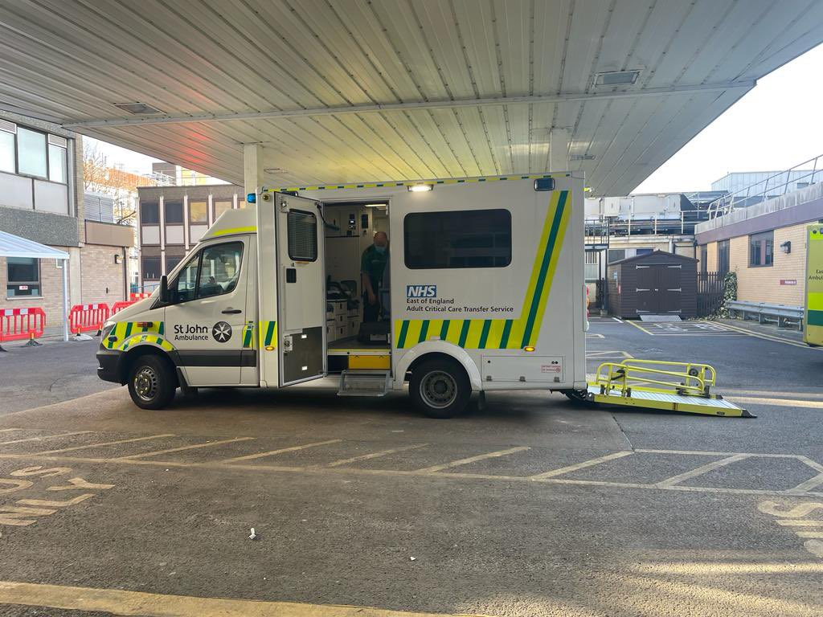
Thank you!
Version 1 – November 2022

Slide 30
Questions?
Version 1 – November 2022

