Slide 1
Human Factors:

Slide 2
Objectives
To understand ‘the dirty dozen’ in relation to human factors.
To discuss ‘the dirty dozen’ and its application within the transfer setting.
To apply the knowledge of ‘the dirty dozen’ to clinical practice within the transfer setting.
Notes:
Human Factors (HF) are environmental, organisational, job factors and environmental characteristics that influence behaviour at work.
HF help ensure your work environment is safer.
HF improve teamwork and cohesion.

Slide 3
What is the dirty dozen?
(Aviation Hunt, 2021)
Notes:
A set of human factors first identified by Gordon Dupont (Dupont,1993).
Applied within the aviation setting, transferable to critical care transfers
12 most common causes of human error pre-conditions to accidents.

Slide 4
1. Lack of Communication
What is a lack of communication?
Failure to receive, transmit or provide enough information to complete a task.
Individuals usually only remember the first and last part of what you say.
Verbal communication = 30% of a message, (Burgoon, 1985).
What affects communication?
Language.
Team culture.
Hierarchy.
Communication styles within the team.
Past experience.

Slide 5
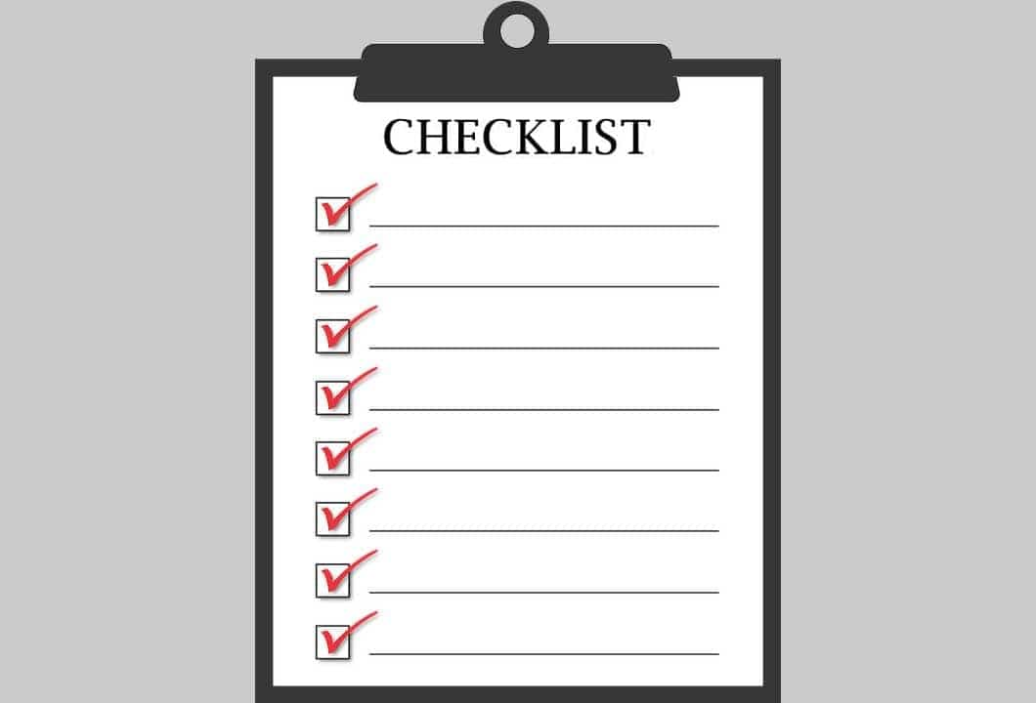
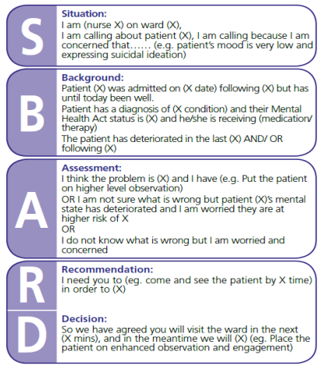
1. Lack of Communication
What can be done to improve communication?
Briefing and debriefing.
Feedback and reflection.
Communication tools (NHS, 2010).
Hands-off handover.
Say the most important things at the beginning then repeat them at the end.
Checklists.
Never assume anything.
Health Education England, 2021

Slide 6
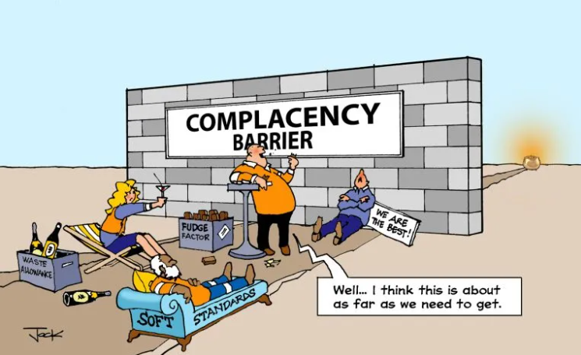
2. Complacency
What is complacency?
Overconfidence from repeated experience performing a task.
How can you overcome complacency?
Expect to find errors.
Checklists.
Learn from your mistakes and others.
Communicate when in doubt.
Don’t sign it off if you didn’t do it.
Mutual checking.
Double check yourself.

Slide 7
3. Lack of Knowledge
What is lack of knowledge?
Shortage of training, information, and/or ability to perform successfully.
Ask yourself:
1. What can you reflect on personally that you have a lack of knowledge?
2. What will you do to improve this lack of knowledge?
How to overcome a lack of knowledge?
Ask when you don’t know.
Attend training.
Use current guidelines/manuals.
Use checklists.

Slide 8
4. Distractions
What is a distraction?
Anything that draws your attention away from the task at hand.
Distractions are the number one cause of forgetting things.
Our mind works faster than our hands and we are always thinking ahead.
Environment.
Personality.
Notes:
Environment: alarms, background noise, relatives, bleeps, mobile phones, other patients, care grouping
Personality: being neurodivegent

Slide 9
4. Distractions
How do you overcome distractions?
How to overcome distractions
Use checklists.
Go back and recheck.
Maintain eye contact in conversation.
Colligan and Bass (2012).
Allow the interruption | Don’t allow the interruption
1. Suspend primary task to allow the higher second priority task and engage immediately | Block the interruption, keeping focus on the primary task
2. Multi-task by dividing attention between primary and secondary task
3. Mediating the interruption with an action that supports resumption of the primary task
Notes:
Colligan and Bass (2012)
Explored distractions during drug rounds of paediatric Nurses, semi structured interview exploring Nurses use to overcome them.
They found that paediatric Nurses either allowed or did not allow the interruption to occur with the following actions

Slide 10
5. Lack of Teamwork
What is a lack of teamwork?
Failure to work together to accomplish a shared goal.
Understand and agreeing on actions to be taken.
Personality differences in the workplace are left outside the workplace
Issues are discussed, clarified, agreed and understood by all team members
What examples can you share?
How did you overcome them?

Slide 11
5. Lack of Teamwork
How to overcome a lack of teamwork
Discuss how a task should be done.
Trust your colleagues.
Make sure everyone agrees and understands.
Team members roles and responsibilities.
Limitations and boundaries.
Individual expectations and concerns.
Notes:
Team responsibilities – team leader delegates responsibility and ensures workload evenly distributed
All team members are aware of the treatment plan
Team member input encouraged and feedback listened to (closed loop communication)
Directive leadership during crisis situation

Slide 12
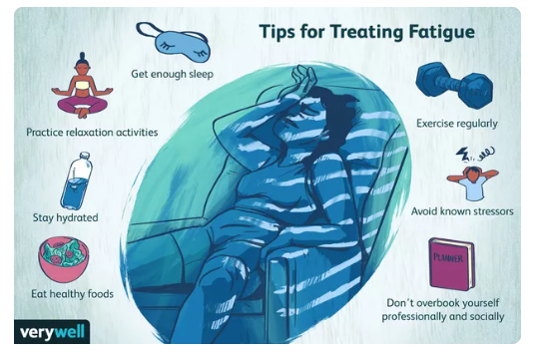
6. Fatigue
What is fatigue?
Faculty of Intensive Care Medicine (2017) defines fatigue as:
‘extreme tiredness resulting from mental or physical exertion or illnesses’.
A fatigued person is easily distracted.
Results in mistakes, poor judgement and wrong decisions, lower standards.
How to overcome fatigue
Watch for symptoms of fatigue in yourself and others.
Have others check your work.
Mindful workload.
Don’t rely on memory when tired.
Don’t overestimate your abilities.
Verywell, 2019 - Online
Notes:
What are you like when you are fatigued?
Evidence-based resources for overcoming fatigue within the critical care environment
https://www.ficm.ac.uk/careersworkforce/wellbeing.
https://www.rcn.org.uk/news-and-events/blogs/fatigue-survey-headlines-and-call-to-action

Slide 13
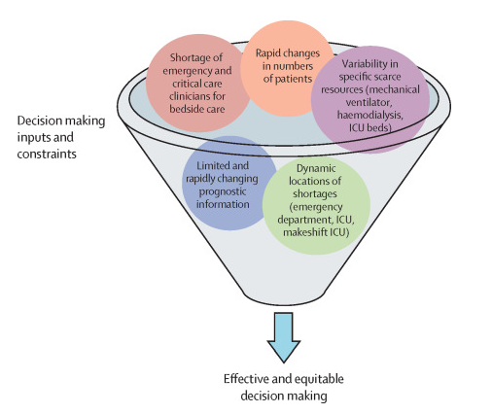
7. Lack of Resources
What is a lack of resources?
Not having enough people, equipment, documentation, time to complete a task.
How to overcome a lack of resources
Have a stand by in place – back up.
Preserving equipment.
Supply of drugs/stock.
Checklist.
Supady et al. (2021)
Notes:
Supday et al, 2021 – Lack of resources pertaining to the covid-19 pandemic. Allocating scarce intensive care resources during the COVID-19 pandemic: practical challenges to theoretical frameworks

Slide 14
8. Pressure
What is pressure?
Real or perceived forces demanding high level job performance.
What situations cause pressure?
How to overcome pressure:
Communicate concerns.
Ask for extra help if time is an issue.
Safety first.
Ensure pressure in not self induced.
How to overcome pressure
1. Focus on one thing
2. Be imperfect – ‘done is better than perfect’
3. Make a list
4. Get physical: go for a walk
5. Delegate
6. Be authentic
Lafair (2021)

Slide 15
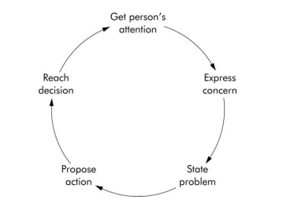
9. Lack of Assertiveness
What is a lack of assertiveness?
Failure to speak up or document concerns about instruction,
orders, or the actions of others.
How to overcome a lack of assertiveness
Express your feelings, opinions, beliefs in a positive, productive
manner.
Express concerns but offer positive solutions.
Resolve one issue before addressing the other.
Omura, Levett-Jones and Stone (2019).

Slide 16
10. Stress
What is stress?
A physical, chemical or emotional factor that causes physical or mental tension.
Notes:
Musculoskeletal System: Muscles tense as a reflex reaction to stress. Chronic stress can lead to tension and migraine headaches, as well as other stress-related musculoskeletal conditions. It can undermine recovery from chronic painful conditions.
Respiratory System: Stress causes you to breathe harder, and getting oxygen can become difficult if you have a lung disease like emphysema. If you have asthma, excess stress can cause an asthma attack. Rapid breathing also can lead to a panic attack.
Cardiovascular System: Acute stress increases heart rate and produces stronger contractions of the heart muscle. Chronic stress can lead to long-term problems for the heart and blood vessels, which can increase risks for hypertension, heart attack or stroke.
Endocrine System: The liver produces more glucose when stressed. Extra blood sugar can cause diabetes for those vulnerable to it, including the obese.
Gastrointestinal System: When stressed, you may eat more food or less food than necessary. If the food you’re eating causes heartburn, stress will increase the pain. The stomach may react to severe stress with nausea, pain or vomiting. If stress is chronic, severe stomach pain and ulcers can develop. Stress can affect digestion and what nutrients are absorbed into the intestines. Food can move through the body at a different pace, leading to diarrhea or constipation.
Nervous System: The fight-or-flight response results in hormones that may elevate heart rate and blood pressure, alter digestion and boost glucose levels.
Reproductive Systems: Excess cortisol affects your reproductive system. Chronic stress for men can impair testosterone and sperm production, as well as cause impotence. Women can experience absent or irregular menstrual cycles or more painful periods, as well as reduced sexual desire.

Slide 17
10. Stress
The hypothalamus sends signals through the autonomic nerves to the adrenal glands, activating the sympathetic nervous system.
The glands respond by pumping adrenaline into the bloodstream.
Adrenaline circulates through the body, causing physiological changes, including increased pulse rate and blood pressure, rapid breathing and sharper senses.
Adrenaline triggers the release of blood sugar and fats from the body’s temporary storage sites, causing nutrients to flood into the bloodstream. This supplies energy to all parts of the body.
After a surge of adrenaline, the hypothalamus activates the second component of the stress response system, known as the HPA axis. The HPA axis consists of the hypothalamus, pituitary gland and adrenal glands, and it uses hormonal signals that keep the sympathetic nervous system active.
If the brain continues to perceive danger, it releases cortisol, which keeps the body on high alert. When the threat passes, cortisol levels decrease, and the parasympathetic nervous system dampens its stress response.
Pathophysiology of Stress

Slide 18
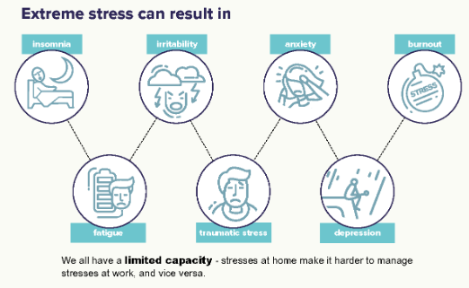
10. Stress
How to overcome stress:
Take a short break when needed.
Discuss the problem with someone who can help.
Take a rational approach to problem solving.
Healthy eating, exercise and sufficient rest reduces
stress levels.
Be self aware, acute stressors, chronic stressors.
Signpost self and others to support services.
Intensive Care Society, 2022
Notes:
Resources for overcoming stress
https://staff.ics.ac.uk/ICU/Policy%20and%20Communications/Articles/Wellbeing_research.aspx
https://www.ics.ac.uk/Society/Wellbeing_hub/Resources_for_Staff

Slide 19
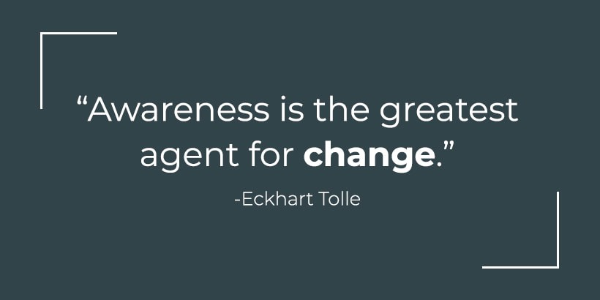
11. Lack of Awareness
What is a lack of awareness?
Failure to recognize a situation, understand what it is, and predict the possible results.
It is a failure to recognize all the consequences of an action or lack of foresight.
How to overcome this?
See the whole picture.
Fully understand the procedures needed to complete a task.
Use colleagues to check.
Notes:
Self awareness theory – (Duval and Wicklund, 1972).

Slide 20
11. Lack of Awareness
Benefits of self awareness:
It can make us more proactive, boost our acceptance, and encourage positive self-development (Sutton, 2016).
Self-awareness allows us to see things from the perspective of others, practice self-control, work creatively and productively, and experience pride in ourselves and our work as well as general self-esteem (Silvia and O’Brien, 2004).
It leads to better decision making (Ridley, Schutz, Glanz, and Weinstein, 1992).
It can make us better at our jobs, better communicators in the workplace, and enhance our self-confidence and job-related wellbeing (Sutton, Williams and Allinson, 2015).
Notes:
Further guidance:
Ackerman, 2020 – barriers to self-awareness and cultivating self-awareness

Slide 21
12. Norms
What are norms?
Norms are short for “normal”, or the way things are normally done.
Unwritten rules that are followed or tolerated by most of the organization.
Negative norms can detract from the established safety standard and
cause an accident to occur.
Just because it seems normal does not make it correct.
How do you break norms?
Help maintain a positive environment with your good attitude
and work habits
Existing norms don’t make procedures right.
Follow SOP’s, policies.
Identify and eliminate negative norms.
(Centre for creative leadership, 2020)
Notes:
What norms can you think of in your practice?
https://www.ccl.org/articles/leading-effectively-articles/the-real-world-guide-to-team-norms/ - Centre for creative leadership (2020)

Slide 22
Summary
The importance of HF, in particular ‘The Dirty Dozen’ is applicable to our practice.
By the end of this session, you should now feel confident in applying ‘The Dirty Dozen’ to your practice.
Applying the principles learned today will improve the safety of your patient and enhance your ability to transfer critically ill patients.

Slide 23
References
Colligan, L., and Bass, E.J., 2012. Interruption handling strategies during paediatric medication administration. BMJ Quality & Safety, 21, pp.912-917.
NHS England., 2010. Safer Care, SBAR. NHS England: London.
Dupont, G., 1993. An Introduction to Aircraft Maintenance Engineering Human Factors for JAR 66. Federal Aviation Authority: Canada.
Burgoon, J. (1985). Nonverbal signals. In M. Knapp & G. Miller (Eds.), Handbook of interpersonal communication (pp. 344-390). Beverly Hills: Sage.
Belbin, R.M., 2010. Team Roles at work. 2nd ed. Philadelphia: Routledge.
Tuckman, B.W. and Jensen, M.A.C., 1977. Stages of small group development revisited. Group and Organization Studies, 2(4), pp.419-27.
Borrill, C. and West, M., 2001. Developing Teamworking in Healthcare: A guide for managers. British Journal of Health Care Management, 6(8), pp.364-71.
Supady, A., Curtis, R., Abrams, D., Lorusso, R., Bein, T. and Boldt, J., 2021. Allocating scarce intensive care resources during the covid-19 pandemic: practical challenges to theoretical frameworks. The Lancet, 9(4), pp.430-434).
Lafair, S., 2021. 10 ways to handle stress under pressure. INC. Available at: <https://www.inc.com/sylvia-lafair/10-best-ways-to-handle-stress-under-pressure.html> [Accessed 20 May 2021].
Fishbein, M. , & Ajzen, I. (2010). Predicting and changing behavior: The reasoned action approach. New York, NY: Psychology Press.
Omura M, Levett‐Jones T, Stone TE. Evaluating the impact of an assertiveness communication training programme for Japanese nursing students: A quasi‐experimental study. Nursing Open. 2019;6:463–472.
Silvia, P. J., & Duval, T. S. (2001). Objective Self-Awareness Theory: Recent progress and enduring problems. Personality and Social Psychology Review, 5, 230–241.
Silvia, P. J., & O’Brien, M. E. (2004). Self-awareness and constructive functioning: Revisiting “the Human Dilemma.” Journal of Social and Clinical Psychology, 23, 475–489.
Sutton, A. (2016). Measuring the effects of self-awareness: Construction of the Self-Awareness Outcomes Questionnaire. Europe’s Journal of Psychology, 12, 645–658.
Sutton, A., Williams, H. M., & Allinson, C. W. (2015). A longitudinal, mixed-method evaluation of self-awareness training in the workplace. European Journal of Training and Development, 39, 610–627.
James, C. (2011). Law student wellbeing: Benefits of promoting psychological literacy and self-awareness using mindfulness, strengths theory, and emotional intelligence. Legal Education Review, 21(2).
Ridley, D. S., Schutz, P. A., Glanz, R. S., & Weinstein, C. E. (1992). Self-regulated learning: The interactive influence of metacognitive awareness and goal-setting. The Journal of Experimental Education, 60, 293–306.
Saunders, P. A., Tractenberg, R. E., Chaterji, R., Amri, H., Harazduk, N., Gordon, J. S., … Haramati, A. (2007). Promoting self-awareness and reflection through an experiential mind–body skills course for first-year medical students. Medical Teacher, 29, 778–784.
Duval, S., & Wicklund, R. A. (1972). A theory of objective self-awareness. Academic Press.
Ackerman, C.E., 2020. What is self-awareness and why is it important?. Online: [https://positivepsychology.com/self-awareness-matters-how-you-can-be-more-self-aware/] Accessed 20 May 2022.
Centre of Creative Leadership, 2020. 10 Steps for establishing team norms. Online: [https://www.ccl.org/articles/leading-effectively-articles/the-real-world-guide-to-team-norms/] Accessed 20 May 2022.

Slide 24
Questions?

