Slide 1
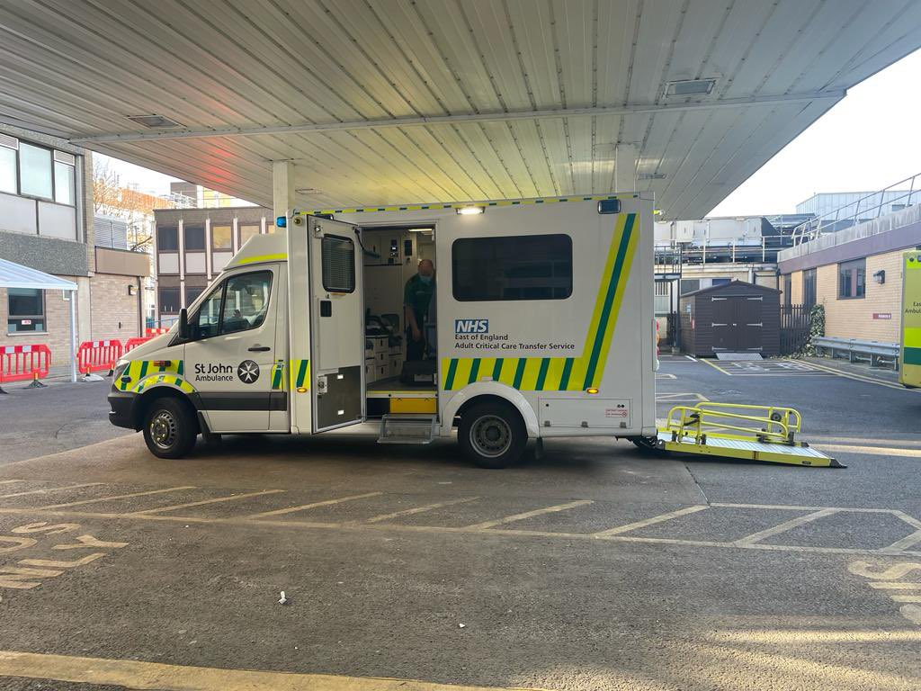
Version 1 – November 2022

Slide 2
Why is there a need for an Adult Critical Care Transfer Service?
High quality transfers are associated with improved patient outcomes (AAGBI, 2019).
Transfer medicine is a rapidly evolving sub speciality (NHS, 2021).
Speciality transfers occur across the East of England (EoE) (neuro, liver, cardiac, trauma, burns) (East of England Critical Care Network, 2021).
Inter-hospital transfers forms part of the patients journey.
Version 1 – November 2022

Slide 3
Who are ACCTS?
Transfer serves 6.3 million adults within the EoE.
Decision-support, triage and coordination of critical care transfers.
Patient-centred, putting our patients first whilst working in partnership with referring and receiving hospitals.
Version 1 – November 2022

Slide 4
Who are ACCTS?
Transfer are a service funded by NHS England.
Transfer will transfer for clinical emergencies, specialist treatment, repatriation and bed capacity.
ACCTS will transfer a patients to any receiving hospital if the referral has come from within the region.
The team consists of a Consultant, A band 6 Transfer Practitioner and an Ambulance Technician.
Version 1 – November 2022

Slide 5
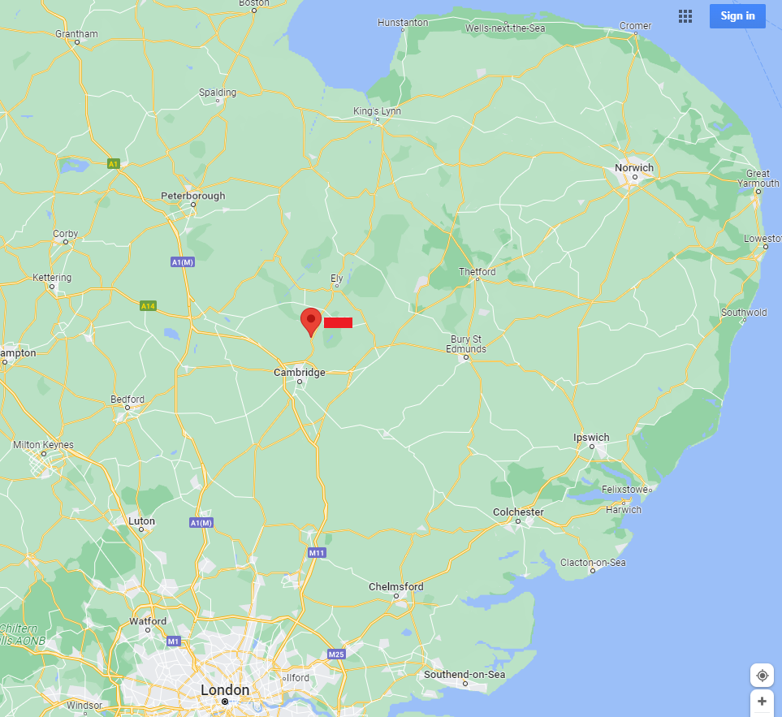
Where are ACCTS located?
Cambridge Research Park, Waterbeach, CB25 9TL.
1 hour from most hospitals in EoE, quicker in emergencies.
Version 1 – November 2022

Slide 6
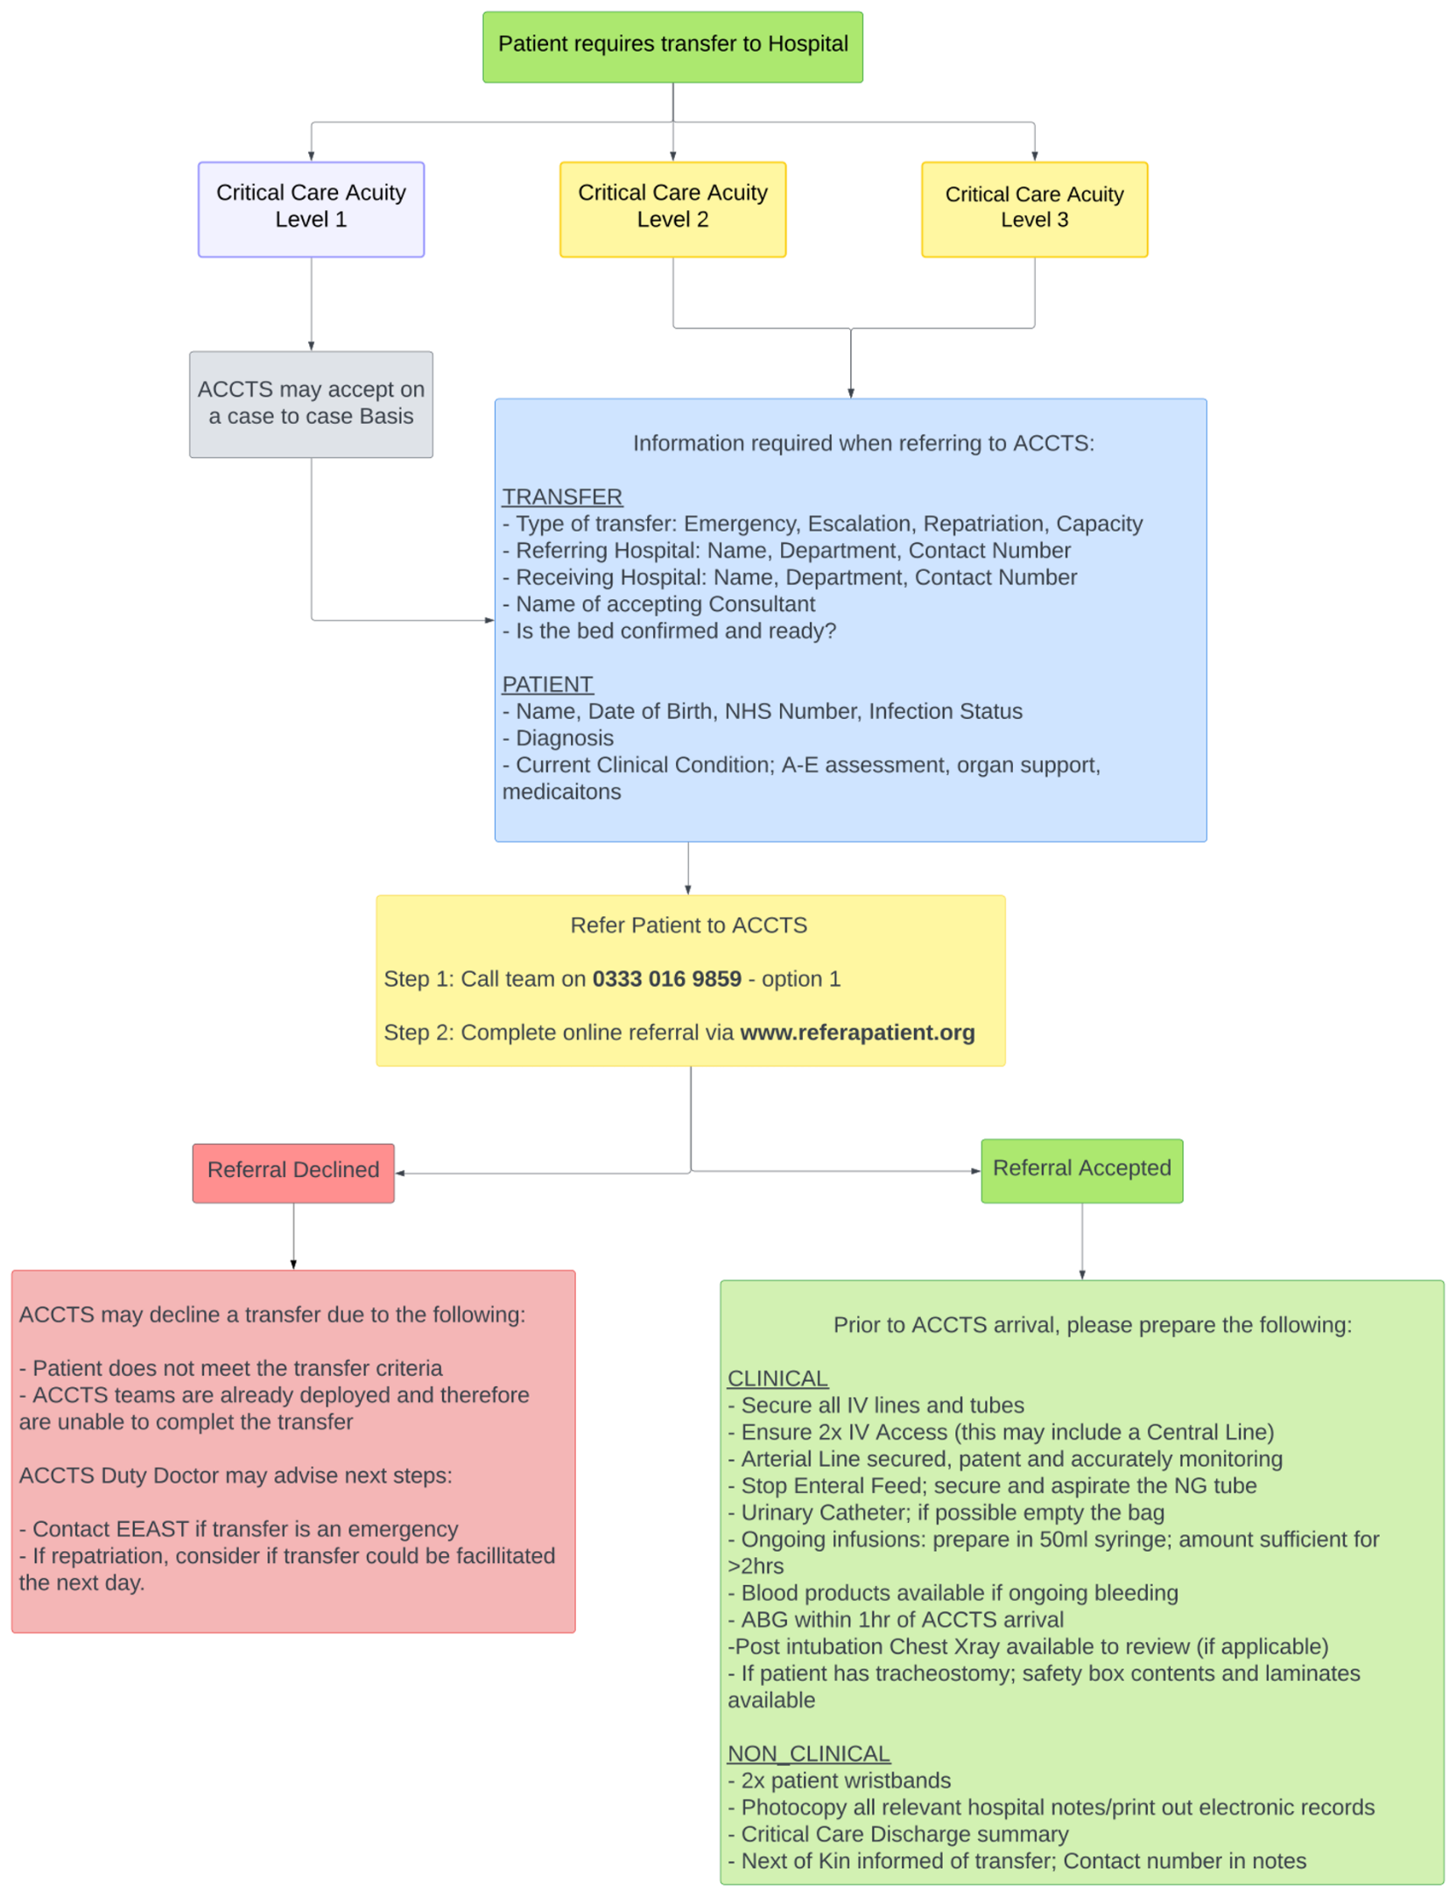
How do I activate ACCTS?
Step 1: Call 0333 016 9859
Step 2: Online referral: https://www.referapatient.org/Patient/TransferServiceV2
Version 1 – November 2022
Notes:
Please refer to the resource pack provided by ACCTS
If you require another resource pack – Please email chris.mead2@nhs.net

Slide 7
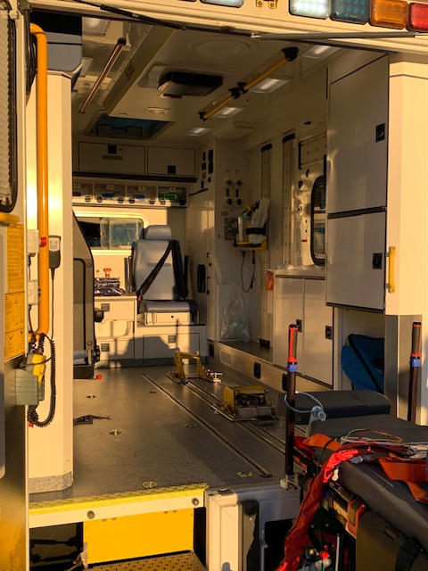
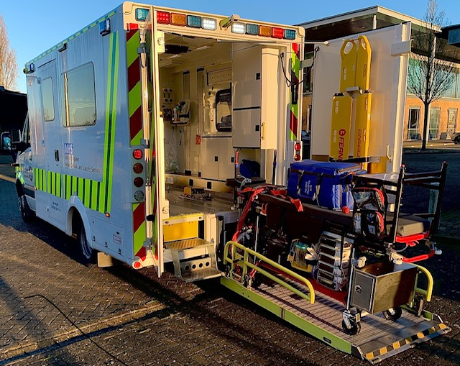
What transport gets used?
C Class Mercedes Ambulance
Wi-fi inside ambulance
Version 1 – November 2022

Slide 8
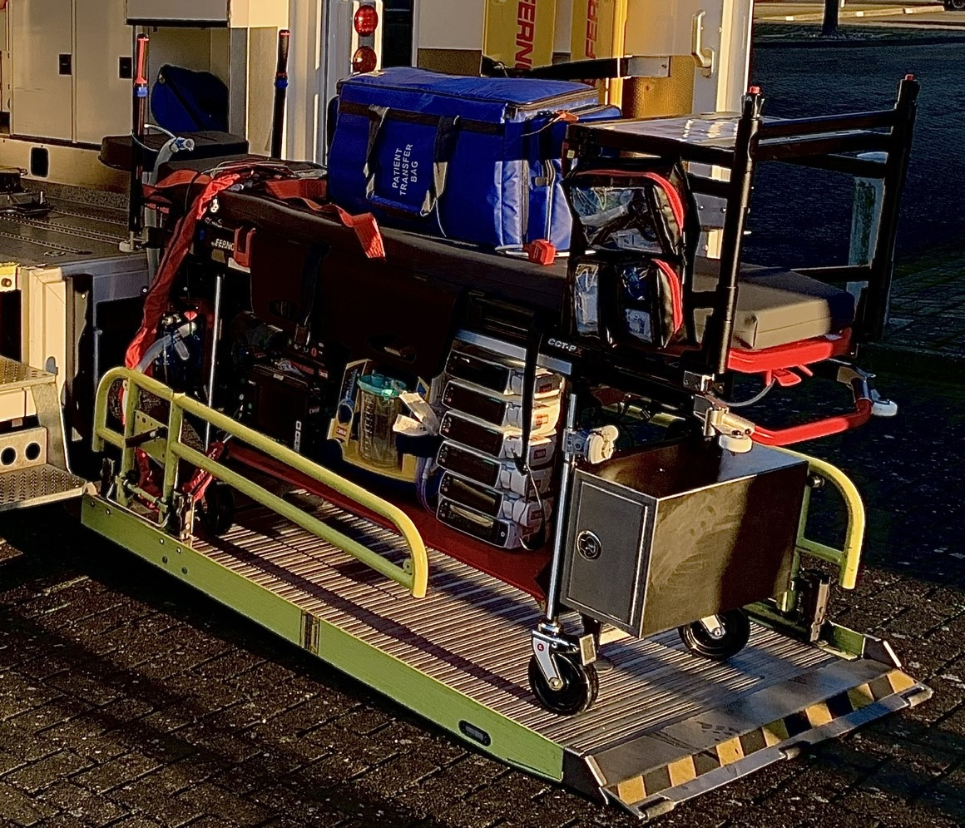
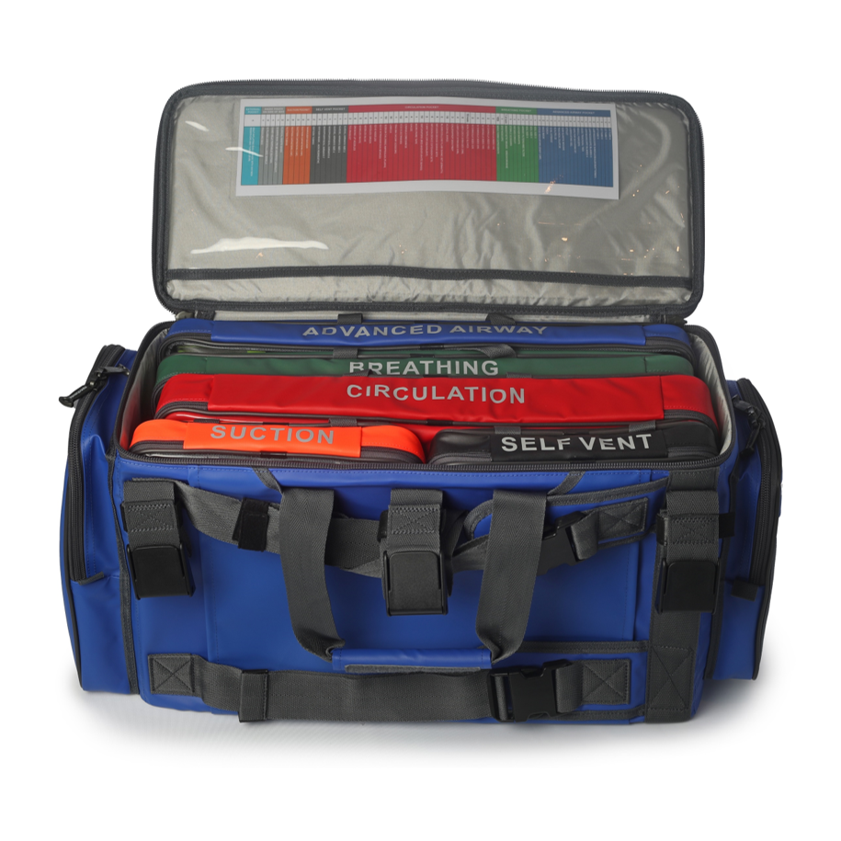
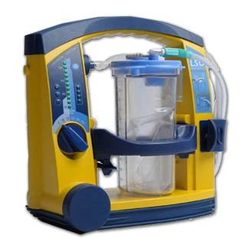
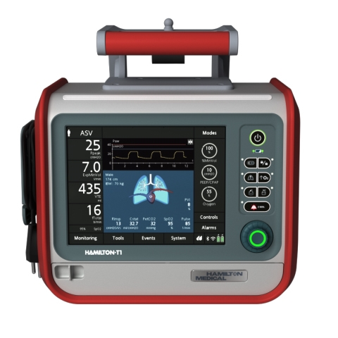
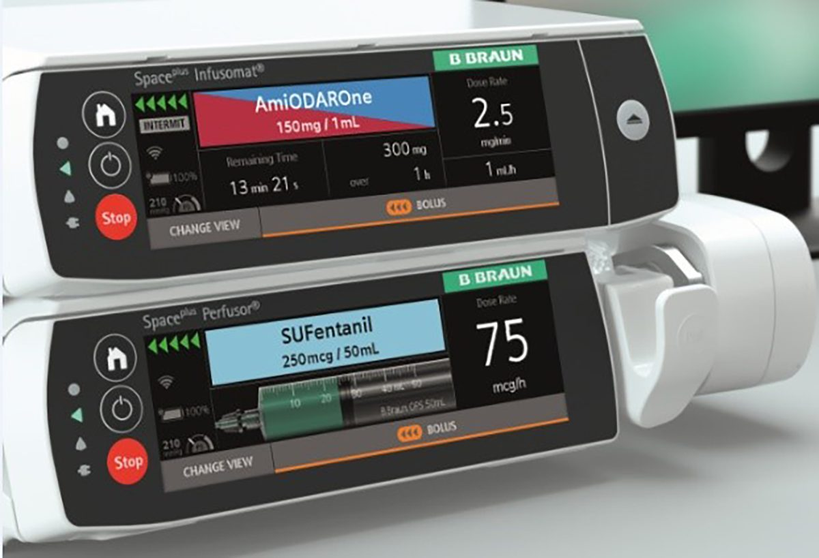
What equipment gets used?
Ferno CEN-compliant trolley (patient weight <250kg)
Dedicated mount and infusion rack
Bbraun space plus infusion pump
Laerdal Suction Unit
Hamilton T1 Ventilator
Medication bag
Equipment bag
Lucas
Version 1 – November 2022

Slide 9
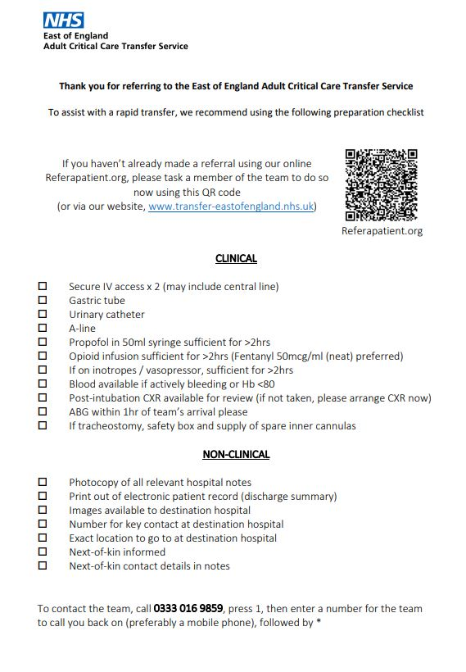
What do I need to do?
Complete the checklist prior to Transfer arrival, prepare patient
Complete referring/receiving hospital feedback (QR code)
Patient feedback (if appropriate)
Transfer admin team, follow up phone call (24-48hrs) at receiving hospital
Version 1 – November 2022

Slide 10
Want to spend time with ACCTS?
Email cctransferserviceadmin@addenbrookes.nhs.uk to register interest in external observer shift.
Complete application form and risk assessment waiver.
Attend shift in appropriate work wear (own uniform and appropriate shoes).
External observer will not participate in any interventions.
Version 1 – November 2022

Slide 11
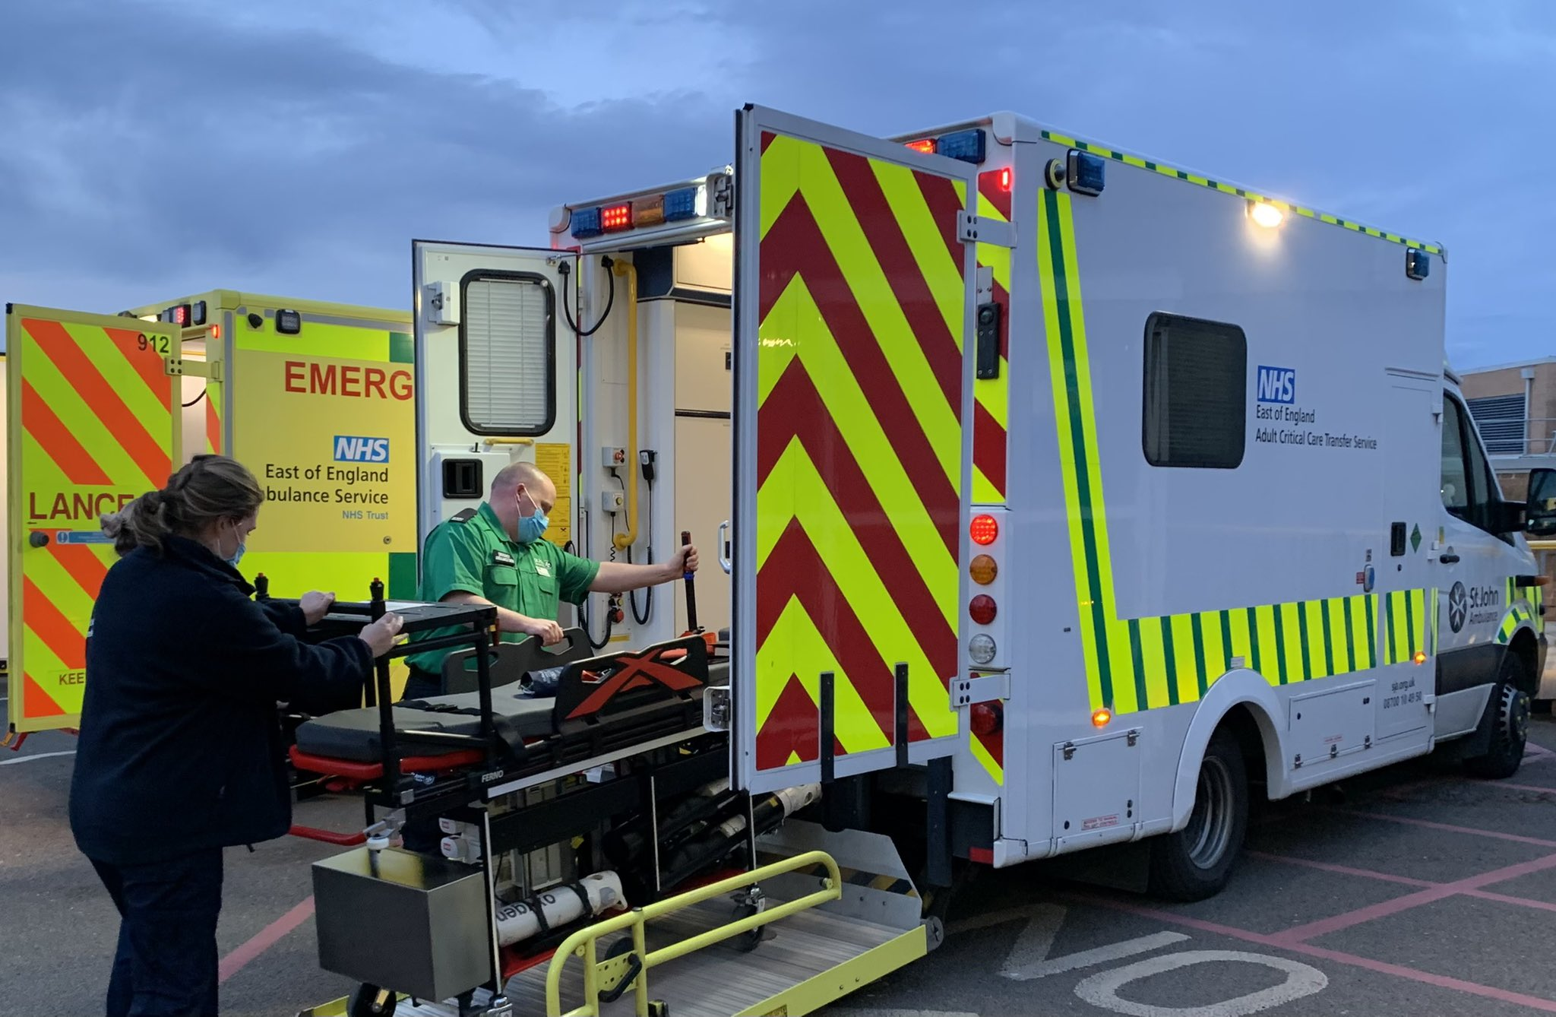
Questions?
Version 1 – November 2022

